Slide 1
HUMAN COMPUTER INTERACTION
LECTURE 4

Slide 2
Problem solving: If reasoning is a means of inferring new information from what is already known, problem solving is the process of finding a solution to an unfamiliar task, using knowledge we have.
Human problem solving is characterised by the ability to adapt the information we have to deal with new situations.
There are number of different views of how people solve problems.
The earliest is the Gestalt View that problem solving both reuse of knowledge and insight.
A second major theory proposed was the problem space theory which takes the view that the mind is a limited information processor.

Slide 3
Gestalt Theory: Problem solving is both and productive and reproductive.
Productive problem solving involves insight and restructuring of problem.
Reproductive problem solving draws on previous experience.
Reproductive problem solving could be a delay to finding solution, since a persons fixed thoughts of known aspects may dominate and so be unable to see novel interpretations that might lead to a solution.
Although Gestalt theory is attractive in terms of its description of human problem solving, it does not provide sufficient evidence or structure to support its theories.
It does not explain when restructuring occurs or what insight is .

Slide 4
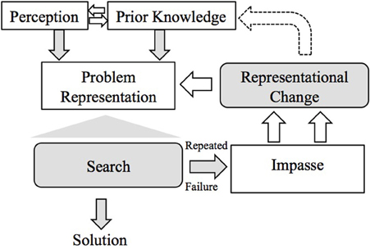

Slide 5
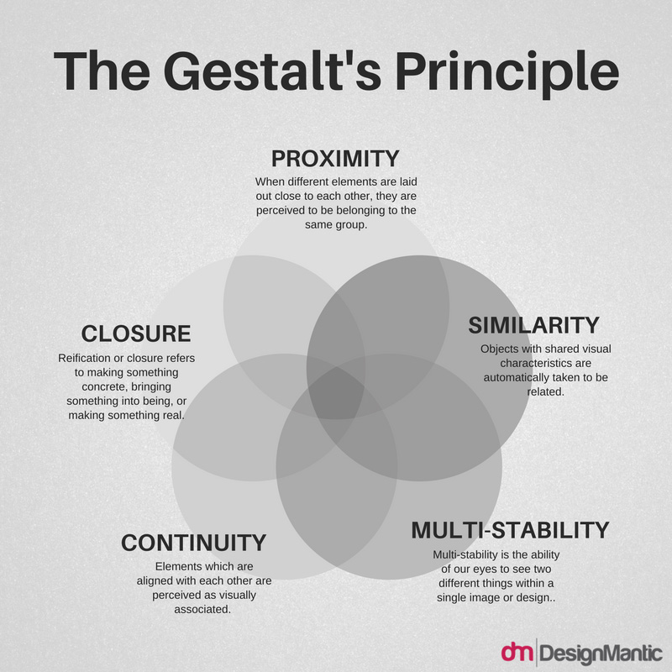

Slide 6
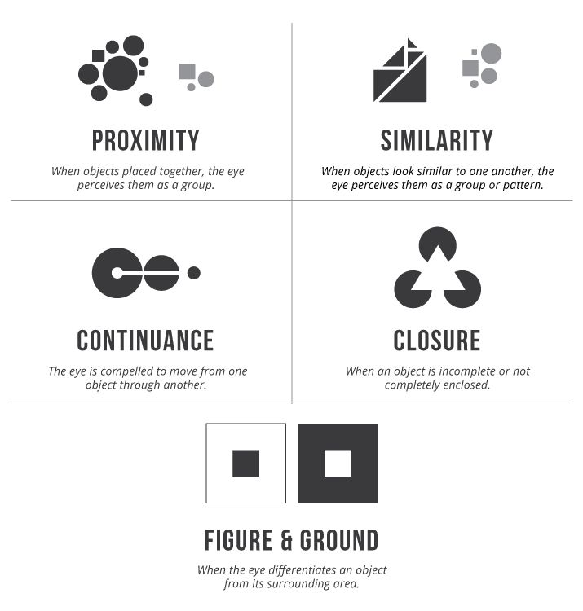

Slide 7
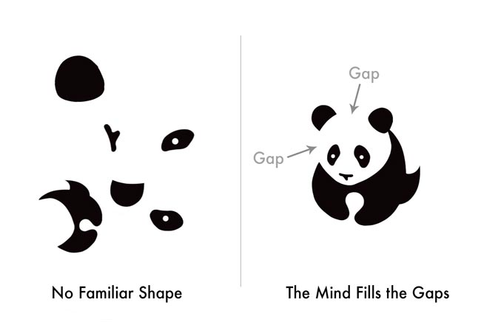

Slide 8
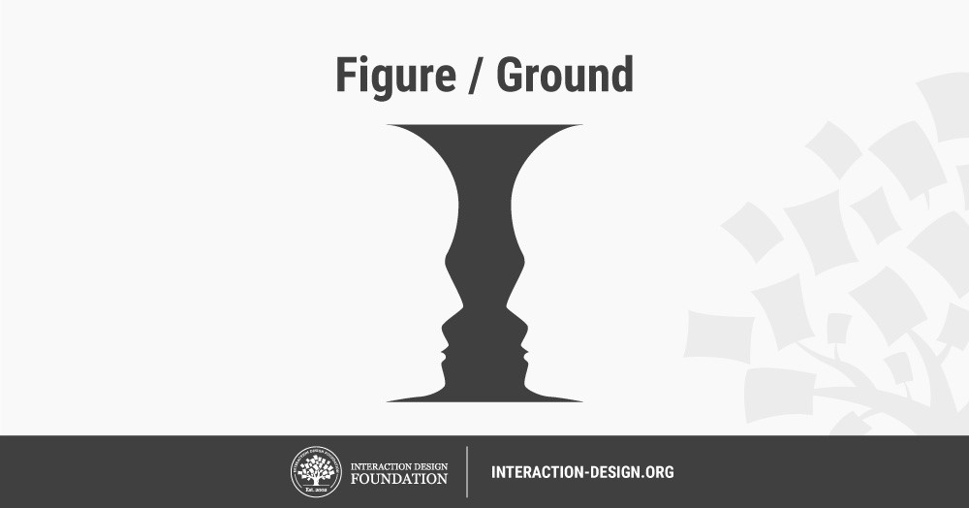

Slide 9
Problem Space Theory- Theory propose that problem solving centres on problem space.
The problem space comprises problem states, and problem solving involves generating these states using legal state transition operators.
The problem has an initial state and a goal state and people use the operators to move from initial to goal state.
If problem spaces are huge, heuristics are employed to select appropriate operators to reach the goal.
One such approach is means – ends analysis.
In means – ends analysis, the initial status is compared with goal state and an operator chosen to reduce the difference between two.

Slide 10
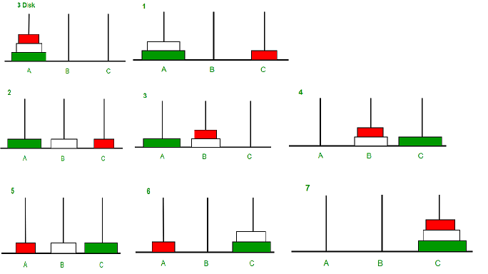

Slide 11
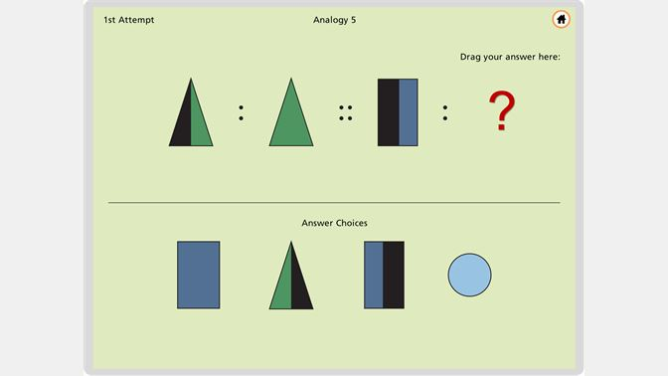
Analogy in problem solving – A third element of problem solving is the use of analogy. Here we are interested in how people solve novel problems.
One suggestion is that this is done by mapping knowledge related to similar known domain to new problem called analogical mapping.
Similarities between the known domain and the new one are noted and operators from the known domain are transferred to the new one.

Slide 12
Emotion: Human emotion is more complex than human perceptual abilities.
Our emotional response to situations affects how we perform.
Positive emotions enable us to think more creatively to solve complex problems, whereas negative emotion pushes us into narrow thinking.
A problem that may be easy to solve when user is relaxed will become difficult if we are frustrated or afraid.
Emotion involves both physical and cognitive events.
Our body responds biologically to an external stimulus and we interpret that in some way as a particular emotion.
That biological response is known as affect- changes the way we deal with different situations and this has an impact on the way we interact with computer systems.

Slide 13
Negative affect can make it harder to do even easy tasks, positive affect can make it easier to do difficult tasks.
This suggests that in situations of stress, people will be less able to cope with complex problem solving or managing difficult interfaces, whereas if people are relaxed they will be more forgiving of limitations in the design.
It suggests that if we build interfaces that promote positive responses for example by using aesthetics or reward then they are likely more successful.

Slide 14
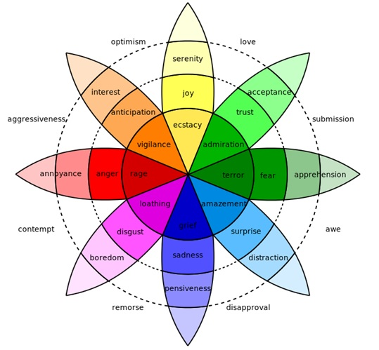

Slide 15
Psychology and the design of interactive systems:
The study of way human receive, process and store information, solve problem is completed but how to apply that knowledge is not clear.
Some conclusion can be made such as recognition is easier than recall.
In order to apply psychological principal in design, we need to understand its context, both in terms of when it fits in wider field of psychology and in terms of measures used and subjects involved.
Principles and results from research in psychology have been included in guidelines of design, models to support design and techniques for evaluating design.

